Slide 1
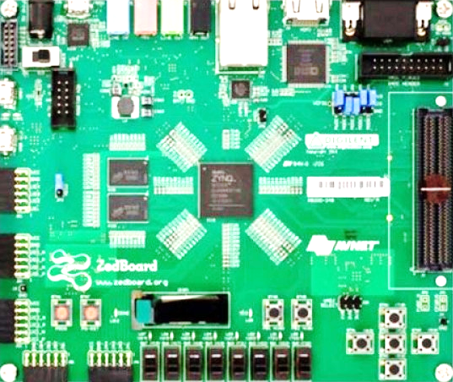
Cryptographic Engineering: Presentation of Assignment 3
13th December 2021
Group <NUMBER>
NAME of Members

Slide 2
<Presentation template> (1)
Describe your design-optimization goal
Your design is here?
Your design is here?
Latency
Area
Throughput
Your design is here?
Or where?

Slide 3
<Presentation template> (2)
Algorithmic choices for the polynomial operations
Details of your implementation
Reasons behind choosing a particular algorithm or a combination of algorithms.
Merits and/or demerits.
…
Architecture diagram of the polynomial multiplier
Architecture diagram of the polynomial unit.
Spend sufficient time here to explain them well.

Slide 4
<Presentation template> (3)
Area and performance results of your polynomial unit and operations
Overall area of the polynomial unit and its sub-modules
Number of clock cycles spent in HW
Number of clock cycles spent in SW
Total number of clock cycles spend in HW + SW

Slide 5
<Presentation template> (4)
Describe the implementation of task 3.
Did the execution of Task 3 (1000 iterations) went well?
Report the performance of executing the PKE protocol (keygen, encryption, decryption).
- Total number of clock cycles spent in HW
- Number of cycles spent in SW.

Slide 6
<Presentation template> (5)
Add a bibliography page where you list all resources you used in your assignment
Remember you have total 10 minutes to present.
You can prepare your presentation using this template or LaTeX with a similar structure

